Slide 1
Parallel Processing and Distribute Computing
Session 03
Course : COSC6100001 - Cloud Infrastructure
D6825 - Samuel Philip

Slide 2
Learning Objectives
At the end of this session, the student will be expected to :
Students able to known and explain the concepts of computer architecture and it complications
Students known about data, thread, and task level on parallelism
Students known and able to describe supercomputer, distributed systems, and modularity

Slide 3
Outline
Computer Architecture Concepts
Grand Architectural Complications
Data, Thread-level, and Task-level Parallelism
From Supercomputers to Distributed Systems
Modularity

Slide 4
Computer Architecture Concepts

Slide 5
Computer Architecture Concepts
Computer architecture describes the functionality, organization, and implementation of computer systems.
Three sub-systems of computer process:
- CPU (Central Processing Unit) : Transforms data
- Memory : Stores data
- I/O (Input/Output) : Supports communication with the outside world

Slide 6

Latency Hiding
The three subsystems of a processor have different bandwidths, i.e., numbers of operations per unit of time, and latency, i.e., the time between the start and the completion of an operation.
CPU registers are the fastest, the main memory is slower by some two orders of magnitude, and I/O devices are orders of magnitude slower than memory.
The impact of this discrepancy on processor performance, due to physical and technological limitations of the three subsystems, can be hidden to some extent through architectural complications and data buffering.
Hiding the latency of slower subsystems is the holy grail of computer architecture. Latency hiding leads to architectural complications, eventually creating the hardware vulnerabilities.

Slide 7

Instruction Set Architecture (ISA)
ISA is an abstract model of a processor defining the set of instructions executed by the CPU. ISA reflects compiler writer's and programmer's view of the processor.
CISC (Complex Instruction Set Computer) and RISC (Reduced Instruction Set Computer) are two competing CPU architectures.

Slide 8

Processor, clock, CPI and IPC
The basic subsystems of a CPU are a Control Unit (CU), an ALU (Arithmetic and Logic Unit), and a Register File (RF).
All CPU activities are controlled by an internal clock. The CU implements a state machine and at each clock cycle dictates what latches should open along the control paths to different circuits and what actions should be carried out. R, the clock rate, is measured in GHz (Gigahertz) (a Hz is one cycle/second and one GHz is 109 Hz).
CPU bandwidth is determined by IPC (Instructions per Clock Cycle) or CPI (Cycle per Instruction), IPC = 1/CPI

Slide 9

.
Processor, clock, CPI and IPC
The larger the IPC, the more performant the processor architecture. T, the execution time of an application, is a function of: N, the number of instructions executed, CPI, and R:
T=N×CPI×R
The only way to decrease the execution time of applications is to increase CPI, R, or both.
The only alternative to boost system performance is to increase the CPI of each CPU and to have multiple cores.

Slide 10
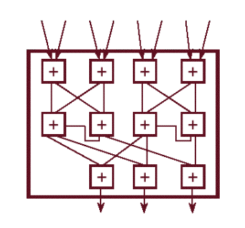
Bit-level and Instruction-level Parallelism
Bit-level parallelism. A computer word is handled as a unit by the instruction set and the processor hardware. The number of bits in a word has increased gradually from 4-bit processors to 8-bit, 16-bit, and 32-bit processors. This has reduced the number of instructions required to process larger size operands and enabled a dramatic performance improvement.
Instruction-level parallelism (ILP). Computers used multi-stage pipelines to speedup execution. Once an n-stage pipeline is full, an instruction is completed at every clock cycle unless the pipeline is stalled.

Slide 11

Performance Metrics and Benchmarks
MIPS (Million Instructions per Second) quantify processor performance for integer arithmetic, while MFLOPS (Million Floating Point Operations per Second) quantify processor performance for floating-point arithmetic.
The information provided by MIPS and MFLOPS is of limited usefulness because processor performance is application-specific.
An application can be CPU-, memory-, I/O-, or all-intensive; the application will run optimally on a processor where the corresponding subsystem, CPU, memory, and I/O is optimized. Applications running on the same processor may run at very different MIPS or MFLOS rates depending on the type of resources intensively used.
The only useful performance characterization of a processor is provided by benchmarks, suites of applications with similar characteristics.

Slide 12
Grand Architectural Complications

Slide 13

Grand Architectural Complications
There is two conditions guarantee computation completion in the shortest possible time:
Memory Optimization and CPU Optimization
The paramount complication is the architecture must ensure program correctness. This means that the architecture should :
Preserve exception behavior
Preserve instruction flow
Preserve security

Slide 14



Memory optimization
Things to consider
Memory Latency : is the time it takes to fetch one instruction, or a word or byte of data
.
Bandwidth : is the amount of data delivered in one unit of time
Cost : the faster, the higher is the cost of physical memory
Notes:
Memory latency is the time it takes to fetch one instruction, or a word or byte of data, measured in picoseconds (psec), nanoseconds (nsec), or milliseconds (msec);
memory bandwidth is the amount of data delivered in one unit of time, measured in GB/sec or MB/sec.
Ideally, the storage should have infinite capacity and bandwidth and zero latency and cost,
but in reality, the storage has limited capacity, finite bandwidth, and non-zero latency.
Memory cost is also a factor: The faster, the higher is the cost of physical memory.
Computers need large memories because the code footprint, as well as the size of data, have been continually increasing.
The cost of very large and very fast memory is prohibitive, and solutions balancing the memory performance and cost have been developed.

Slide 15
CPU Optimization
Major implications in keeping the pipe full at the times for cpu optimization:
B1—avoid pipeline stalls;
B2—deal with the fact that different arithmetic operations require a different number of clock cycles; for example, an integer addition my require two clock cycles, a multiplication 12 clock cycles, and a division 50–60 clock cycles;
B3—avoid wasting clock cycles due to control flow instructions which alter the sequential execution pattern. A control flow instruction could be a condition generated by an arithmetic operation that modifies condition codes and may or may not force us to fetch a new instruction, or a subprogram call or an instruction that transfers control to a subprogram or elsewhere in the address space of the program.

Slide 16

Critical vulnerabilities
There are two hardware vulnerabilities that affect systems with Intel x86, IBM Power architectures, and some ARM microprocessors :
Meltdown vulnerability exploits a race condition between memory access and privilege checking during instruction processing and affects x86-based systems.
Spectre enables a whole class of potential vulnerabilities by exploiting branch prediction.
This Photo by Unknown Author is licensed under CC BY-SA

Slide 17
Data, Thread, and Task-level parallelism

Slide 18
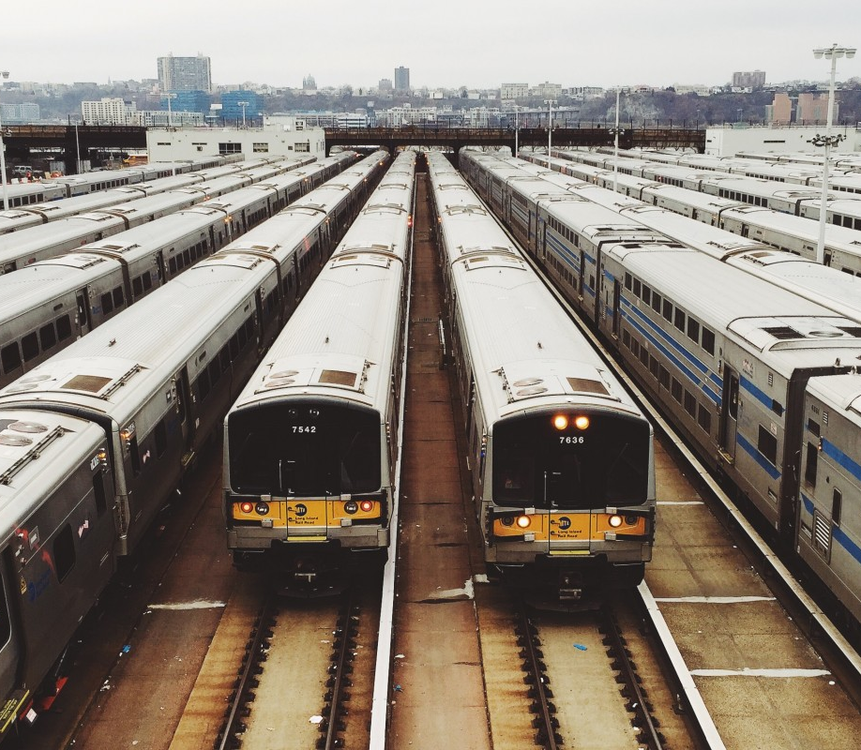
Data-level parallelism
Data-level parallelism is an extreme form of coarse-grained parallelism.
It is based on partitioning data into large chunks / blocks / segments and running concurrently either multiple programs or copies of the same program, each on a different data block.
In the latter case the paradigm is called Same Program Multiple Data (SPMD).
There are the so-called embarrassingly parallel problems where little or no effort is needed to extract parallelism and to run a number of concurrent tasks with little or no communication among them.

Slide 19
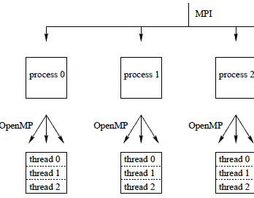
Thread is a subset of vector elements processed by one of the lanes of a multithreaded processor,
the use of thread-level is for data-parallel using a GPU. It can be used on single and multicore processor to run multiple processes concurrently.
Database applications are memory-intensive and I/O-intensive; and multiple threads are used to hide the latency of memory and I/O access.
In the context of scheduling, a job consists of multiple tasks scheduled either independently or co-scheduled when they need to communicate with one another
This Photo by Unknown Author is licensed under CC BY

Slide 20
Thread-level and Task-level Parallelism
Cloud computing is an appealing environment of running applications attempting to identify optimal model parameters that best fit experimental data.
Such applications involve computationally intensive tasks.
Multiple instances running concurrently test the fitness of different sets of parameters, and the results are then compared to determine the optimal set of model parameters.
There are also numerical simulations of complex systems that require an optimal design of a physical system.
Multiple design alternatives are compared, and the optimal one is selected according to several optimization criteria.
This Photo by Unknown Author is licensed under CC BY

Slide 21
From supercomputers to distributed systems

Slide 22

Supercomputer
A supercomputer is a computer that performs at or near the highest operational rate for computers.
Supercomputer architectures are made up of multiple central processing units (CPUs). These CPUs have groups composed of compute nodes and memory. Supercomputers can contain thousands of nodes that use parallel processing to communicate with one another to solve problems.
Supercomputers have been used for scientific and engineering applications that must handle massive databases, do a great amount of computation or both.

Slide 23
sUPERCOMPUTER
The next natural step to increase the computing power was possible due to advances in communication networks
when low-latency and high-bandwidth Wide Area Networks (WANs) allowed individual systems, many of them multiprocessors, to be geographically separated.
Large-scale distributed systems were first used for scientific and engineering applications and took advantage of the advancements in system software, programming models, tools, and algorithms developed for parallel processing.

Slide 24

Distributed system
A distributed system is a collection of computers connected through a network and a distribution software called middleware, which enables computers to coordinate their activities and to share the resources of the system.
The middleware should support this set of desirable properties of the distributed system
Access transparency; Location transparency; Concurrency transparency;
Replication transparency; Failure transparency; Migration transparency;
Performance transparency; Scaling transparency;
This Photo by Unknown Author is licensed under CC BY-SA

Slide 25
Distributed system
characteristics
Its components are autonomous, meaning scheduling and other resource management and security policies are implemented by each system.
There are multiple points of control and multiple points of failure in a distributed system, and some sources may not be accessible at all times.
Distributed systems can be scaled-up by adding more resources and can be designed to maintain availability even at low levels of hardware/software/network reliability.
This Photo by Unknown Author is licensed under CC BY-SA

Slide 26
Modularity

Slide 27
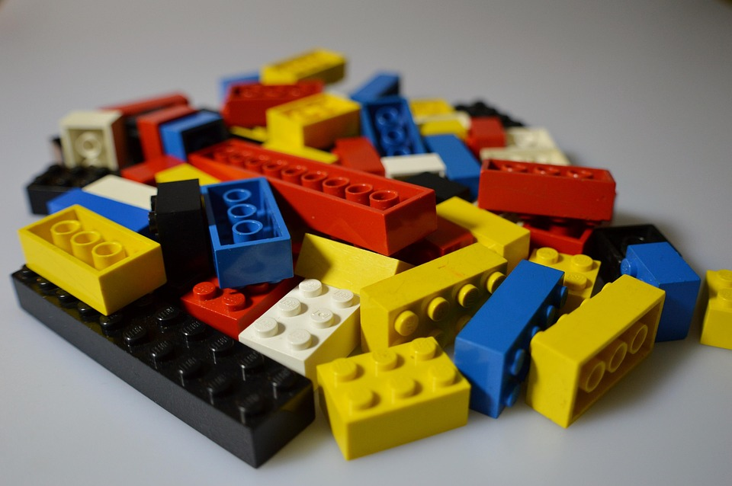
Modularity
Modularity is a basic concept in the design of man-made systems; a system is made out of components, or modules, with well-defined functions.
Modularity supports the separation of concerns, encourages specialization, improves maintainability, reduces costs, and decreases the development time of a system.

Slide 28
Principles of modular software
Information hiding;
Invariant behavior;
Data generality;
Secure arguments;
Recursive construction;
System resource management;
Notes:
Information hiding; the user of a module does not need to know anything about the internal mechanism of the module to make effective use of it.
Invariant behavior; the functional behavior of a module must be independent of the site or context from which it is invoked.
Data generality; the interface to a module must be capable of passing any data object an application may require.
Secure arguments; the interface to a module must not allow side-effects on arguments supplied to the interface.
Recursive construction; a program constructed from modules must be usable as a component in building larger programs or modules.
System resource management; resource management for program modules must be performed by the computer system and not by individual program modules.

Slide 29
Soft Modularity
Soft modularity hides the details of the implementation of a module
The former implies dividing a program into modules that call each other and communicate using shared-memory or follow the procedure call convention.
This Photo by Unknown Author is licensed under CC BY-SA

Slide 30
Soft Modularity
Benefit
Soft modularity hides the details of the implementation of a module
Once the interfaces of the modules are defined, the modules can be developed independently;
A module can be replaced with a more elaborate, or with a more efficient one, as long as its interfaces with the other modules are not changed;
The modules can be written using different programming languages and can be tested independently.
This Photo by Unknown Author is licensed under CC BY-SA

Slide 31

Enforced Modularity
Enforced modularity modules need to be forced to interact only by sending and receiving messages.
This paradigm leads to a more robust design: The clients and the servers are independent modules and may fail separately.
The system is more robust because it does not allow errors to propagate. Enforced modularity makes an attack less likely because it is difficult for an intruder to guess the format of the messages or the sequence numbers of segments, when messages are transported by TCP.

Slide 32
Exercise
Find article related to implementation of Supercomputer and distributed systems

Slide 33
References
Marinescu, Dan C. (2022). Cloud Computing Theory and Practice: 3rd Edition. Morgan Kaufmann Publishers. ISBN: 978-0-323-85277-7

Slide 34
Thankyou

